Slide 1

SMART COLLEGE
MIRYALA PRANATHI
23UP1A05F5
CSE-C 2ND YEAR
Under the Guidance of
Mrs. B. Ramyasri
Assistant Professor
Department of Computer Science and Engineering
Smart College

Slide 2
INDEX
Abstract
Introduction
Literature review
Proposed system
Methodology
System Architecture and
use case diagrams
System Requriments
Advantages and Disavantages
Conclusion
Reference

Slide 3
Abstract
Concept of smart college can one be of the emerging trend in ML in coming up years where the thought of ‘Smart Campus, Secure Campus’ may become the new mantra. Our project focus on helping the management for taking quick attendance and it also help teachers to predict which student can be able to get a placement or not. This project is also helpful in knowing about the college for newly joined students through an interactive chat bot .Furthermore, the project will present and discuss an idea about smart college using the concepts of Machine Learning.

Slide 4
Introduction
Smart College is a web application which we have developed to provide a platform to students who are lacking the interaction with the other students and adapting to the college environment needed at present and are willing to adapt those skills. Our projects help them to learn about their standards using placement prediction module.

Slide 5
Literature review
Fuzail, Muhammad & Noman, Fahad & Mushtaq, Muhammad Omer & Raza, Binish & Tayyab, Awais & Talib, Muhammad introduce a new approach to automatic attendance management systems, extended with computer vision algorithms. We propose using real-time face detection algorithms integrated into an existing Learning Management System (LMS), which automatically detects and registers students attending a lecture. The system represents a supplemental tool for instructors, combining algorithms used in machine learning with adaptive methods used to track facial changes during a longer period of time. This new system aims to be less time-consuming than traditional methods, at the same time being nonintrusive and not interfering with the regular teaching process. The tool promises to offer accurate results and a more detailed reporting system that shows student activity and attendance in a classroom.

Slide 6
pPROPOSED SYSTEM
In the proposed system, we have integrated two distinct operations: the Smart College Operation and the College Social Networking System, creating a cohesive and unified platform. This integration allows scholars to access their academic reports and council events conveniently in one place. The admin plays a crucial role in this operation, possessing full authority to manage and modify pupil's academic details, including additions, updates, and cancellations. Additionally, the Admin oversees the social networking aspect to facilitate seamless communication and student engagement. Furthermore, we have introduced the Library Module, enabling scholars to request library books online for greater convenience and efficiency.

Slide 7
Methodology
Vision and Planning:
Define the Vision and Goals:
  Identify Key Stakeholders: Include students, faculty, administrative staff, IT department, alumni, and potentially industry partners.
  Conduct Needs Assessment: Gather input from all stakeholders through surveys, focus groups, and interviews to understand their pain points, needs, and aspirations for a smart college environment.

Slide 8
System Architecture:
Smart intelligent featured apps used in college
Face attendance system
Placements Prediction
Interactive Chatbot
Frontend technologies and core functionalities
Html and css based pages
All functionalities
Handled through python
Different Machine learning models
Backend technologies
Sql database
Excel sheets

Slide 9
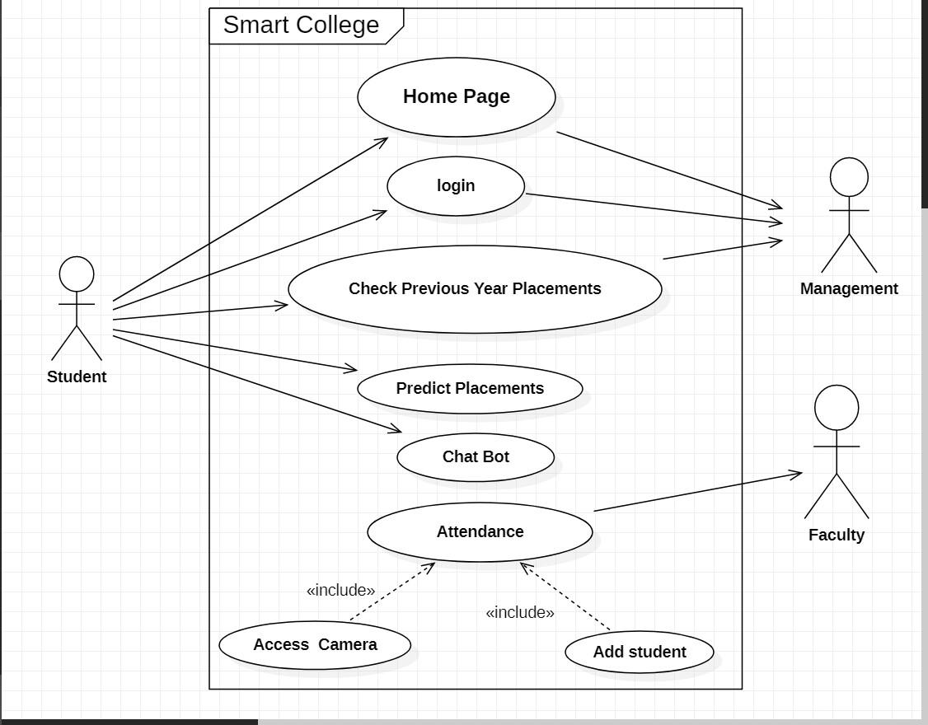
Use case diagrams

Slide 10
Modules In the Use Case Diagram are:
Home Page, Login, Check Previous Year Placements, Predict Placements, Chat Bot and Attendance.
There are mainly 3 actors in the Use Case Diagram :
1.) Student
2.) Faculty
3.) Management
Student: Mainly a student can predict placements, make queries in the chat bot and look over the previous year placements.
Faculty: The Main function of the faculty is to take attendance in fair and secure manner through camera.
Management: Management mainly controls the login credentials and overall functioning of the Smart College System.

Slide 11
System Requirements:
Python Libraries which include : Numpy ,sklearn ,pandas ,opencv,flask and nklt
Tool used : Pycharm Editor
For database tool used: Microsoft Sql Server Management studio
For Frontend Technologies Used : Html,Css, JavaScript
Computer Specifications Required: 4 Gb ram, Windows Os, 2 Gb Rom.

Slide 12
Advantages
  Interactive and Engaging Content: Multimedia resources, simulations, and virtual labs can make learning more dynamic and easier to understand.
  Personalized Learning: AI-powered platforms can adapt to individual student needs, learning paces, and preferences, offering tailored content and feedback.
  Increased Accessibility: Online resources, recorded lectures, and digital libraries provide learning opportunities anytime, anywhere, catering to diverse student schedules and learning styles.

Slide 13
Disadvantages
implementation and Maintenance Costs:
  Significant investment is required for hardware, software, network infrastructure, and the integration of various systems.
  Ongoing costs for software licenses, updates, maintenance, and technical support can be substantial
Digital Divide and Accessibility Issues:
  Not all students may have equal access to the necessary technology (devices, reliable internet), potentially exacerbating existing socioeconomic disparities.
  Ensuring that smart systems are accessible to students with disabilities requires careful planning and implementation of inclusive design principles.

Slide 14
Conclusion
This system aims to build an effective class management system using modern technical features. The proposed system will be able to mark the attendance via face recognition and can control IoT and we can share things online via the app. But the technology world developing exponentially. So, we have to constantly upgrade our system so that it will be the most efficient and effective for future generations, especially our students.

Slide 15
References
https://scikit-learn.org/stable/modules/svm.html
https://www.tutorialspoint.com/tutorial_view.htm?cid=flask&pid=
https://www.w3schools.com/html/
https://www.w3schools.com/js/
https://towardsdatascience.com/cnn-based-face-detector-from-dlib-c3696195e01c

